Slide 1

MSTD TS DOCUMENTATION PROJECT
Copyright @<>. All Rights Reserved. Private and Confidential.

Slide 2

Case Study
ABOUT CLIENT
<> provides extensive services in SAP.
Current project- <>.
OUR CONTRIBUTION
Gemini Consulting & Services has contributed by providing consultants for this enormous project and completed the Documentation project for all modules.
Project co-ordination to project completion all tasks were carried out Project Co-Ordinator/Technical Writer from Gemini.
SUCCESS
The project scope was initially for 400 objects, which later on exceeded with CRM objects. Total 835 objects were completed at the end of the project with high-quality and by achieving project delivery deadline.

Slide 3
Process Flow Best Practice
Requirements Gathering- Clear Understanding of the client’s requirements for the Technical Specification for Maharashtra State Government project
Planning & Designing- Planning of the Technical Specification project with all the SMEs. Designing the template for TS document
Information Gathering- Setting up knowledge transfer meetings between SMEs and offshore ABAP team
Writing- Writing the document in the TS Template
Review – Internal review and then client final review
Implementation- Implementing the client feedback and sending the updated draft
Sign-Off– Getting a final sign-off for each document that has met client expectation

Slide 4
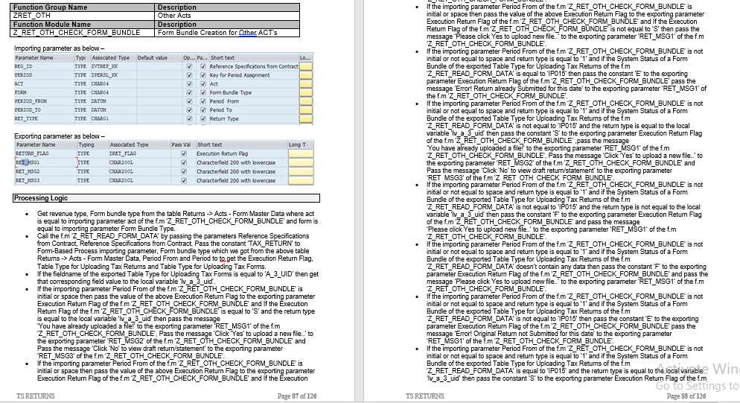
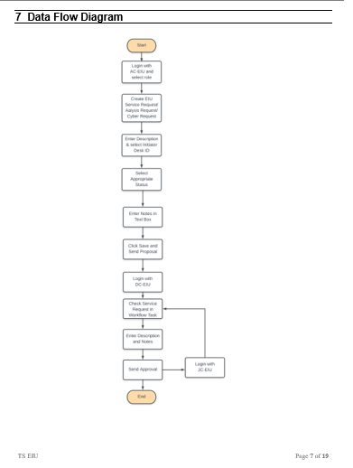
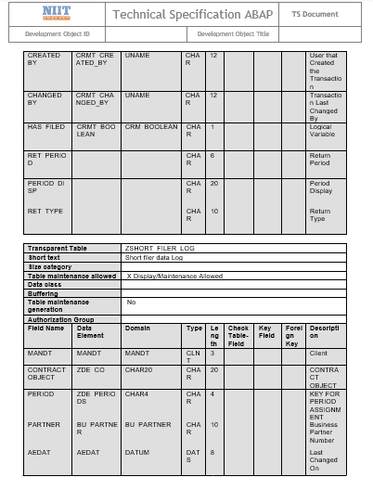
Documentation
The Technical Specification document describes the various objects like Function Modules, Tables, Reports, Classes, BADI, BSP components, Webdynpro components and the programmed logic for each object. Here, are the samples of the document below from modules like Refund, Payments and Recovery.

Slide 5

Lessons Learned
01
Importance of requirements gathering by collecting the client’s needs and concerns and responding to those in a timely fashion.
02
Setting clear expectations and accurately assessing core team resources and Commitments in relation to projected project timelines
03
Establishing trust and rapport between Gemini and client team leads so that they can work closely together to handle whatever comes up on the project.
04
Deep knowledge transfer from SMEs to the offshore team for drafting the logic. Great insight on ABAP objects .
05
Documenting the logic shared by the offshore team in the template as per Technical writing guidelines
06
Value of a strong partnership at the project management level between client and core teams.

Slide 6
THANK YOU.
Copyright @2019, Gemini Consulting & Services. All Rights Reserved. Private and Confidential.

